Slide 1
Physical Changes

Slide 2

By the end of this lesson, you should be able to:
Identify a physical change.
Understand the different types of physical changes.

Slide 3
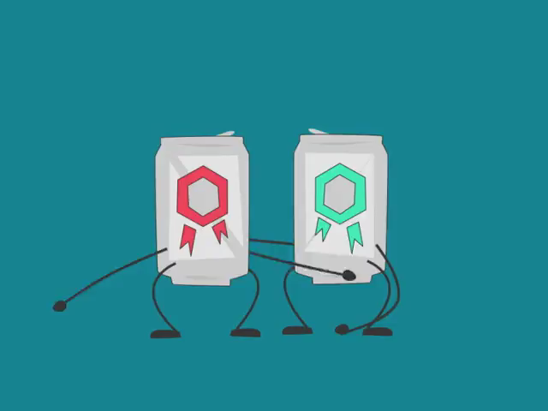
An example of a physical change is a change in shape or form.
Breaking, bending, twisting, crushing or compressing the substance are examples of this. These do not make new substances, and so are a type of physical change.
An example of this is recycling the aluminium used in cans - cans are crushed up and then reused to make new cans!

Slide 4
Mixing two substances together is another type of physical change.
An example of this is mixing flour with milk. The flour and milk themselves are unchanged, with no new substances formed, but are now mixed together.
This can be reversed by evaporating the milk away to give flour and milk solids, and then separating the two.

Slide 5
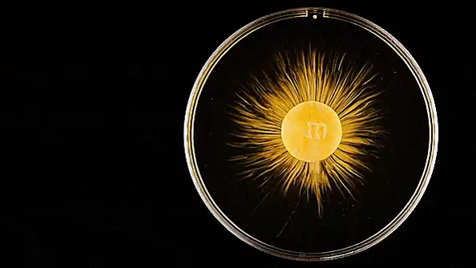
Dissolving a solute is a physical change.
An example is sugar dissolving into water. This is a physical change because there is no change in the chemical makeup of the water or sugar - one is just dissolved in the other.
The water can also be evaporated off, leaving the sugar behind, making this process reversible.

Slide 6
When a substance is heated, the particles move further apart because they have more energy.
This increases the volume of a substance without changing the chemical composition.
This is expansion. It results in a larger volume and lower density because of increased heat.

Slide 7
When a substance is cooled, the particles move closer together because they have less energy.
This is contraction. It results in a smaller volume and higher density because of decreased heat, without changing the chemical composition.
Wooden houses expand during warm days and contract during cooler nights. This is what you are hearing when your house creaks!

Slide 8
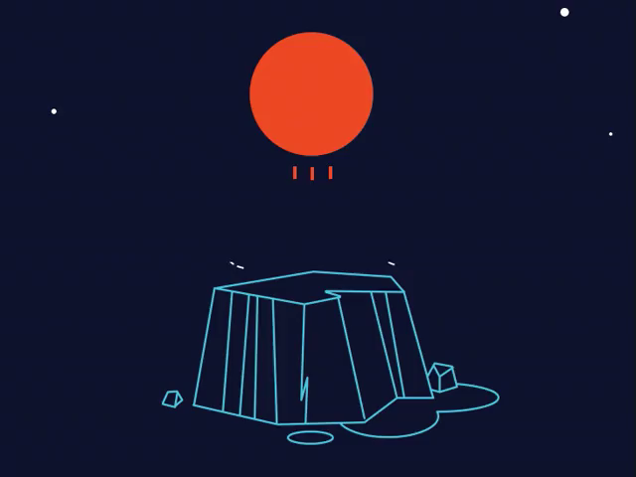
Heating or cooling a substance enough can cause it to undergo a state change.
A substance's chemical makeup does not change when it changes state. State changes are therefore physical changes.
A heated substance will either melt or vaporise.
A cooled substance will either freeze or condense.

Slide 9
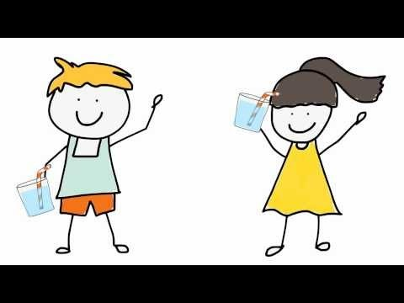

Slide 10
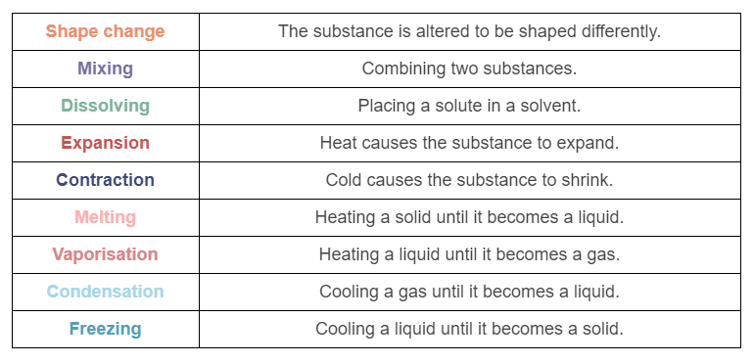
Here is a list of the different types of physical changes!

